Slide 1
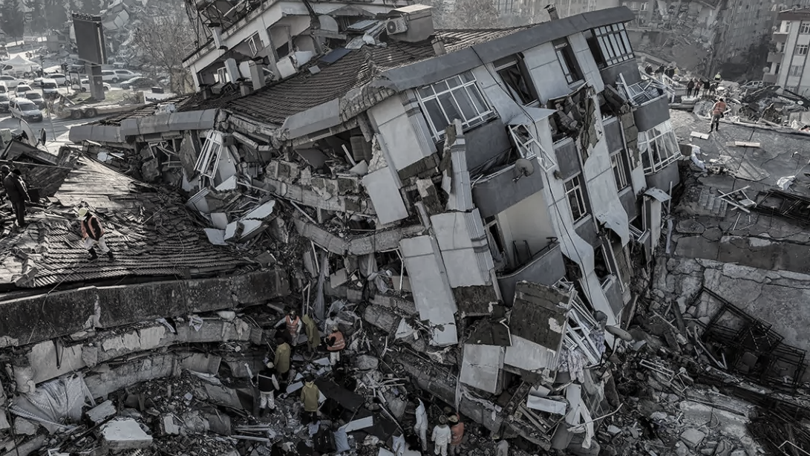
EARTHQUAKES
Presented by:
Rachel Brimble, Jody-ann frazer, Rafed Mahbub and Ugochi Prince ajuobi
15th August 2023

Slide 2
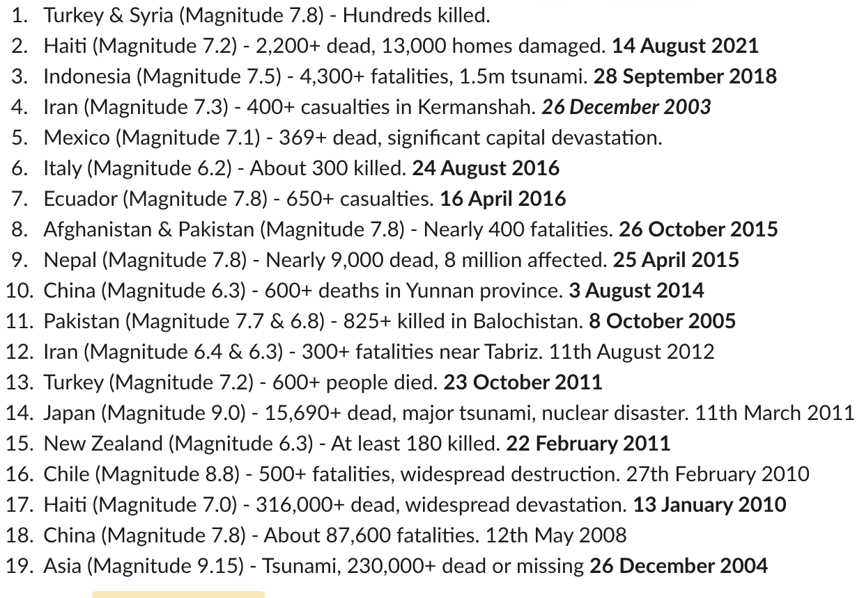
A timeline of the world’s strongest earthquakes over the last 20 years
Notes:
https://www.independent.co.uk/news/world/europe/strongest-ever-earthquake-world-recorded-turkey-b2276494.html

Slide 3
Background
Earthquakes can strike suddenly and without warning. An earthquake is a violent and abrupt shaking of the ground, caused by movement between tectonic plates along a fault line in the earth’s crust. Earthquakes can result in ground shaking, soil liquefaction, landslides, fissures, avalanches, fires and tsunamis. The extent of destruction and harm caused by an earthquake depends on:
magnitude
intensity and duration
the local geology
the time of day that it occurs
building and industrial plant design and materials
the risk-management measures put in place
Between 1998-2017, earthquakes caused nearly 750 000 deaths globally, more than half of all deaths related to natural disasters. More than 125 million people were affected by earthquakes during this time period, meaning they were injured, made homeless, displaced or evacuated during the emergency phase of the disaster.
Notes:
https://www.who.int/health-topics/earthquakes#tab=tab_1

Slide 4
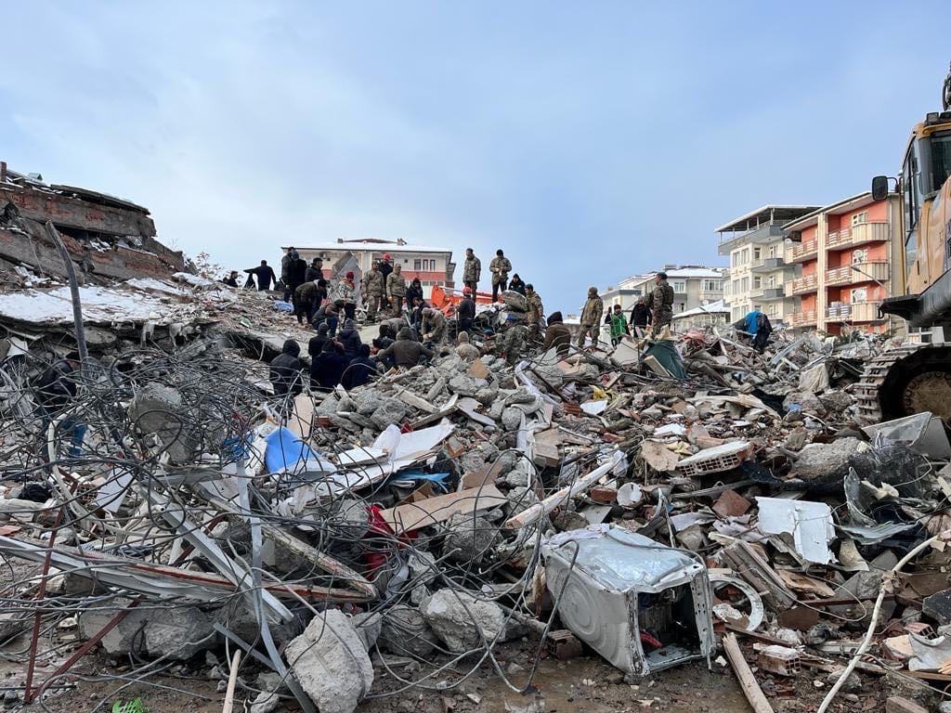
7.8 Magnitude
Turkey-Syria
2023
Haiti
Indonesia
Iran
On Feb. 6, a magnitude 7.8 earthquake occurred in southern Turkey near the northern border of Syria. This quake was followed approximately nine hours later by a magnitude 7.5 earthquake .
Mexico

Slide 5
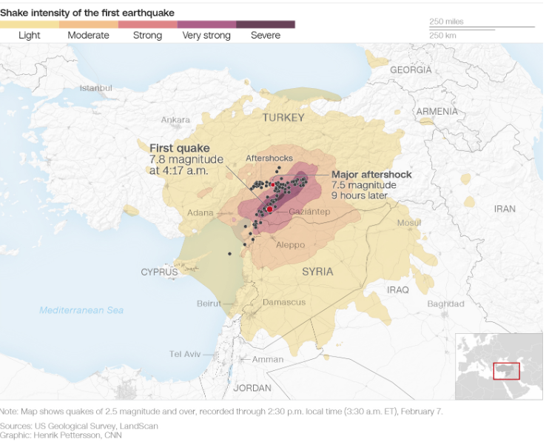
7.8 Magnitude
Turkey-Syria
2023
Haiti
Indonesia
Iran
Mexico
The first earthquake was the most devastating to hit earthquake-prone Turkey in more than 20 years and was as strong as one in 1939, the most powerful recorded there.

Slide 6
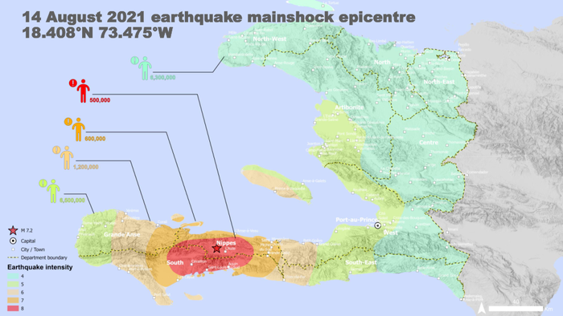
7.2 Magnitude
Turkey-Syria
Haiti
2021
Indonesia
Italy
Just before 8:30 a.m. ET on Aug. 14, an M7.2 earthquake struck the southwest of Haiti in the mountains between the Nippes Department and Sud Department. This earthquake occurred at a depth of only 6.2 miles (10 km), which is critical because shallow earthquakes usually cause more damage.
Nepals

Slide 7
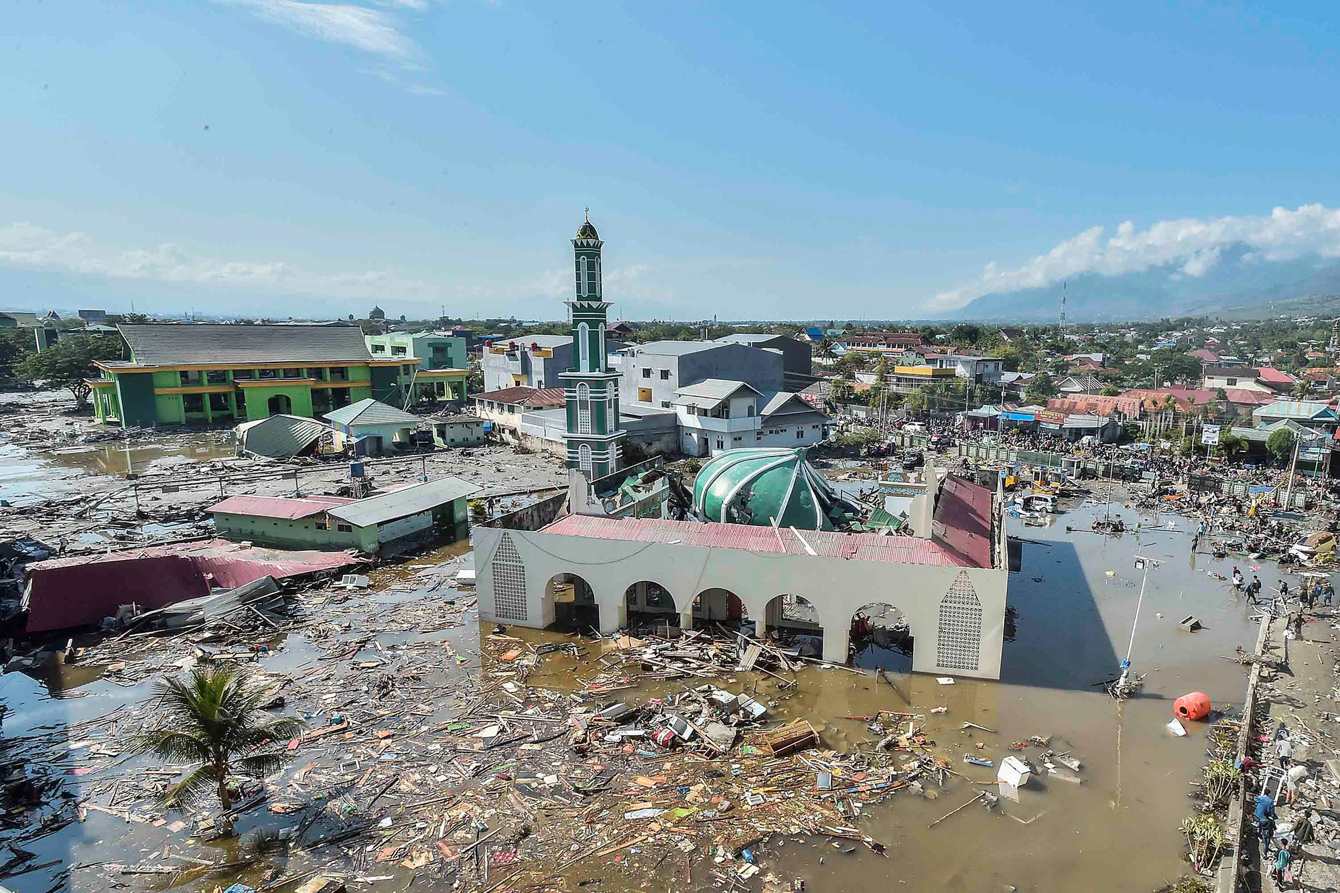
7.5 Magnitude
Turkey-Syria
Haiti
Indonesia
2018
Italy
On Friday 28th September 2018, an earthquake of 7.4 magnitude struck the central province of Sulawesi in Indonesia. This was followed by a tsunami with waves of up to six metres. 1.5 million people were affected and hundreds of thousands of survivors were left without food, water and shelter.
Mexico

Slide 8
Introduction
Welcome to "Earthquakes and Trends," where we embark on a journey through historic data to analyse the trends of earthquakes over the last 20 years.
According to long-term records (since about 1900), the USGS (United States Geological Survey) concludes we expect about 16 major earthquakes in any given year. That includes 15 earthquakes in the magnitude 7 range and one earthquake magnitude 8.0 or greater. In the past 40-50 years, our records show that we have exceeded the long-term average number of major earthquakes about a dozen times. The year with the largest total was 2010, with 23 major earthquakes (greater than or equal to magnitude 7.0). In other years the total was well below the annual long-term average of 16 major earthquakes. 1989 only had 6 major earthquakes and 1988 only had 7.
In this presentation, we delve into data to answer a vital question: Are earthquakes on the rise?
we aim to achieve the following outcomes:
A comprehensive understanding of global earthquake patterns and their relationship with tectonic plate boundaries.
Visual representations of earthquake occurrences
Insightful graphs depicting trends in earthquake frequency
Research into the causes of observed trends and their implications
Notes:
https://www.independent.co.uk/news/world/europe/strongest-ever-earthquake-world-recorded-turkey-b2276494.html

Slide 9
Data Sources
The research data were obtained from the following public data sources for global occurrences:
https://www.usgs.gov/faqs/why-are-we-having-so-many-earthquakes-has-naturally-occurring-earthquake-activity
https://imgnew.outlookindia.com/uploadimage/library/16_9/16_9_5/IMAGE_1675913944.webp
Background information:
https://www.actionaid.org.uk/our-work/emergencies-disasters-humanitarian-response/tsunami-in-indonesia-2018
https://www.independent.co.uk/news/world/europe/strongest-ever-earthquake-world-recorded-turkey-b2276494.html
https://www.who.int/health-topics/earthquakes#tab=tab_1
Notes:
https://www.independent.co.uk/news/world/europe/strongest-ever-earthquake-world-recorded-turkey-b2276494.html

Slide 10
DATA COLLECTION AND ANALYSIS
CREATING DATA DASHBOARD
USING API TO DISPLAY MARKERS OF EARTHQUAKES
USING TECTONIC PLATE DATA TO PLOT LINES
USING LEAFLET PLUGINS TO CREATE FEATURES ON MAP
WEBSCRAPPING HISTORIC DATA
USING SQL DATABASE TO CALL DATA
USING PLOTY TO DISPLAY INYTERACTIVE GRAPHS

Slide 11
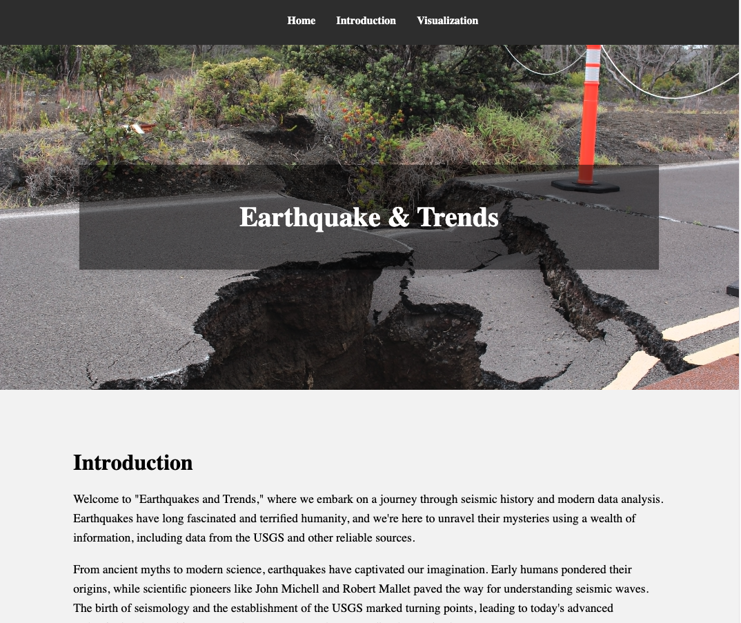
DASHBOARD
We started off with creating a dashboard with navigation menu around the page for the research which would help viewing our visualisations and project summary easily using data analysis tools like html, css, javascript and other libraries. This was deployed to github pages which creates a link for anyone to visit the dashboard easily more like a website link in simple terms found below:
https://ugochiprince.github.io/Earthquakes/

Slide 12
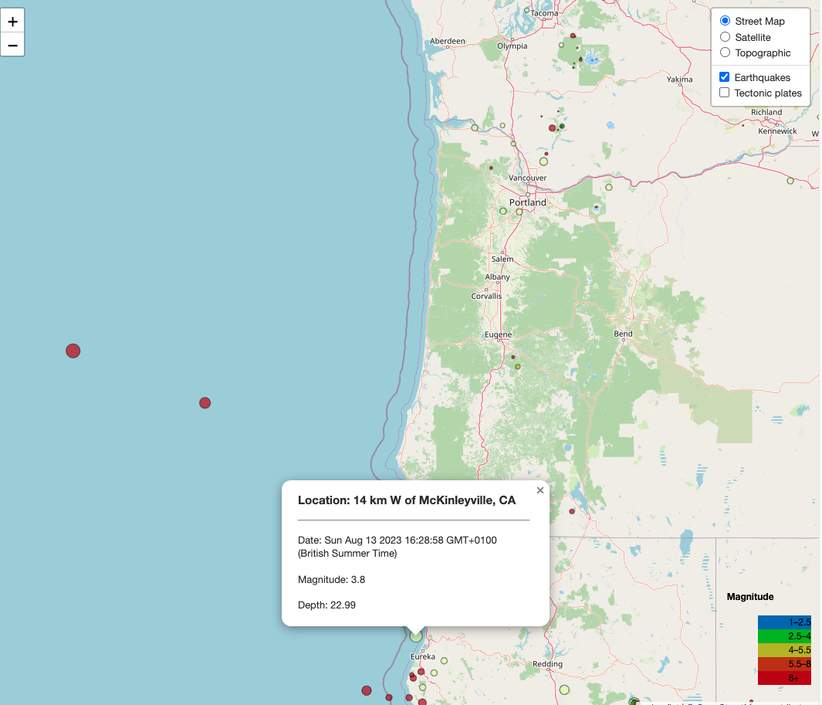
DATA VISUALISATION- EARTHQUAKE OCCURRENCE
We used API data to create visualisations showing the different global views of earthquake occurrences by location. We included a layer displaying tectonic plates as well as a clickable and popup map with zoom features.

Slide 13
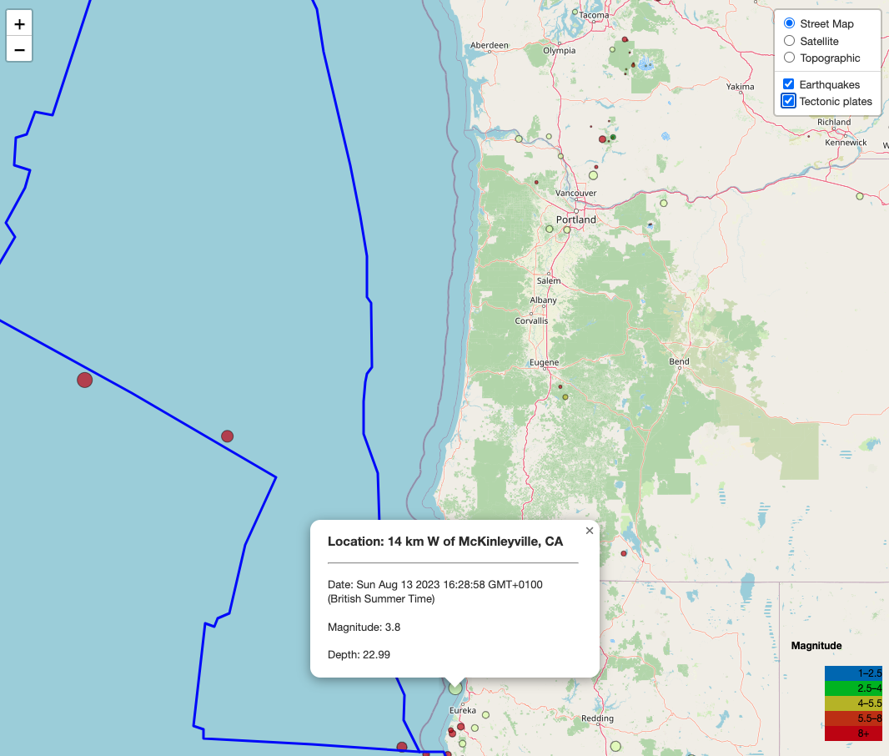
DATA VISUALISATION- EARTHQUAKE OCCURRENCE
We used API data to create visualisations showing the different global views of earthquake occurrences by location. We included a layer displaying tectonic plates as well as a clickable and popup map with zoom features.

Slide 14
DATA VISUALISATION- HISTORIC DATA
We went further to then clean and scrape required data to create visualisations showing trends in earthquake occurrences over the last 20 years then used a Plotly chart to answer the question posed; “ARE EARTHQUAKES ON THE RISE?"

Slide 15
Conclusion
From this project we found out:
In this research, we had limitations :
Limited data and data sources
Time for in-depth research
In conclusion, our analysis sheds light on the complex nature of earthquake trends. Understanding these patterns is crucial for disaster preparedness and mitigation. Future research could focus on predictive modelling and advanced monitoring technologies to enhance our ability to anticipate and manage seismic events.
Recommendations: WHA 64.10 Strengthening national health emergency and disaster management capacities and resilience of health systems

Slide 16


